Slide 1

AI-Powered Customer Support Workflow
Japheth Gordon
AI Automation | Project 1

Slide 2
Introduction
Today, we'll explore the challenges in our customer support process, including long wait times and inconsistent information across channels like phone, email, and chat.
Our goal is to improve efficiency by integrating Artificial Intelligence solutions to streamline operations and enhance the customer experience.
Let’s dive into the challenges, expected AI improvements, and the specific tools to achieve our objectives.

Slide 3
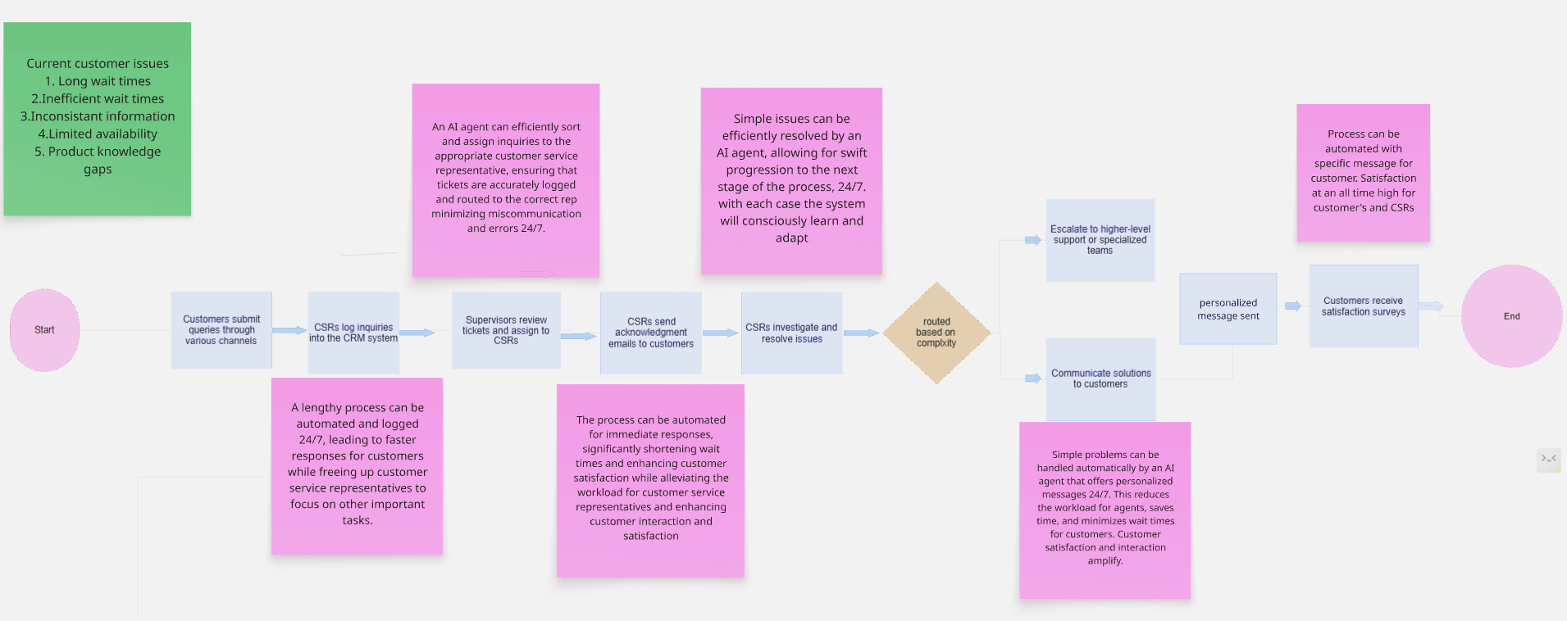
Current Workflow Overview

Slide 4
Key Problems Identified
1. Current Challenges in Customer Service
Long Wait Times: Customers experience excessive delays before reaching a representative.
Inefficient Ticket Management: Issues are often misrouted, causing frustration and the need for repeated explanations.
Inconsistent Information: Customers receive conflicting information from different agents.
Limited Availability: Support is restricted to business hours, leaving customers without assistance outside these times.
Knowledge Gaps: Agents may lack sufficient product knowledge, leading to unresolved inquiries.

Slide 5
Proposed AI Integrations
A. Zendesk
Key Features: Automated ticket management, AI-powered chatbots, robust analytics.
Benefits: Enhances customer satisfaction by reducing wait times and streamlining ticket handling.
B. Freshdesk
Key Features: Multi-channel support, AI ticket prioritization, strict security protocols.
Benefits: Provides comprehensive support and improves efficiency by automating repetitive tasks.
C. Salesforce Service Cloud
Key Features: Integration flexibility, personalization capabilities, strong security measures.
Benefits: Facilitates a tailored customer service experience while ensuring data security.

Slide 6
Proposed AI integration
Expected benefits and improvements
Here are five expected benefits and improvements from using the top AI tools (Zendesk, Freshdesk, and Salesforce Service Cloud):
Faster Response Times: AI chatbots and automated ticketing will enable immediate acknowledgment and resolution of common inquiries, substantially reducing wait times for customers.
Enhanced Efficiency: Automation of routine tasks allows customer service representatives to focus on more complex issues, increasing overall productivity and effectiveness.
Improved Customer Satisfaction: Personalized interactions and consistent responses through AI tools lead to a better customer experience, fostering loyalty and trust.
Accurate Ticket Routing: AI-driven systems will ensure that inquiries are correctly categorized and assigned to the appropriate representatives based on expertise and availability, minimizing miscommunication.
Ongoing Insights and Adaptation: Analytics capabilities of these tools will provide valuable insights into customer interactions, enabling continuous improvement and adaptation of service strategies over time.

Slide 7
Potential Risks and Limitations
1. Technical Challenges: Complexity in integrating AI with existing systems.
2 . User Resistance: Employees may be hesitant to adopt new technologies.
3. Data Security and Compliance: Ensuring strict adherence to data protection regulations.
4. Dependence on Technology: Risk of reduced human problem-solving skills.
5. Quality Control: Need for accurate and fair AI outputs to maintain trust.

Slide 8
Improved Customer Workflow
-Customer Inquiry Submission: Inquiries via email, phone, chat, and social media.
-Automated Ticket Creation: AI logs and categorizes inquiries automatically.
-Hierarchical Routing with AI: Intelligent routing to appropriate CSRs based on -expertise and workload.
-Personalized Acknowledgment: CSRs send tailored acknowledgment emails with -estimated resolution times.
-AI-Driven Issue Investigation: Agents access knowledge bases with AI assistance -for quick resolutions.
-Complex Issue Handling: AI suggests escalation for unresolved issues.
-Real-Time Updates: Automated follow-ups keep customers informed.
-Feedback Collection: Post-resolution surveys gather customer insights.
-Ongoing Learning: AI analyzes interactions to continuously refine support processes.

Slide 9
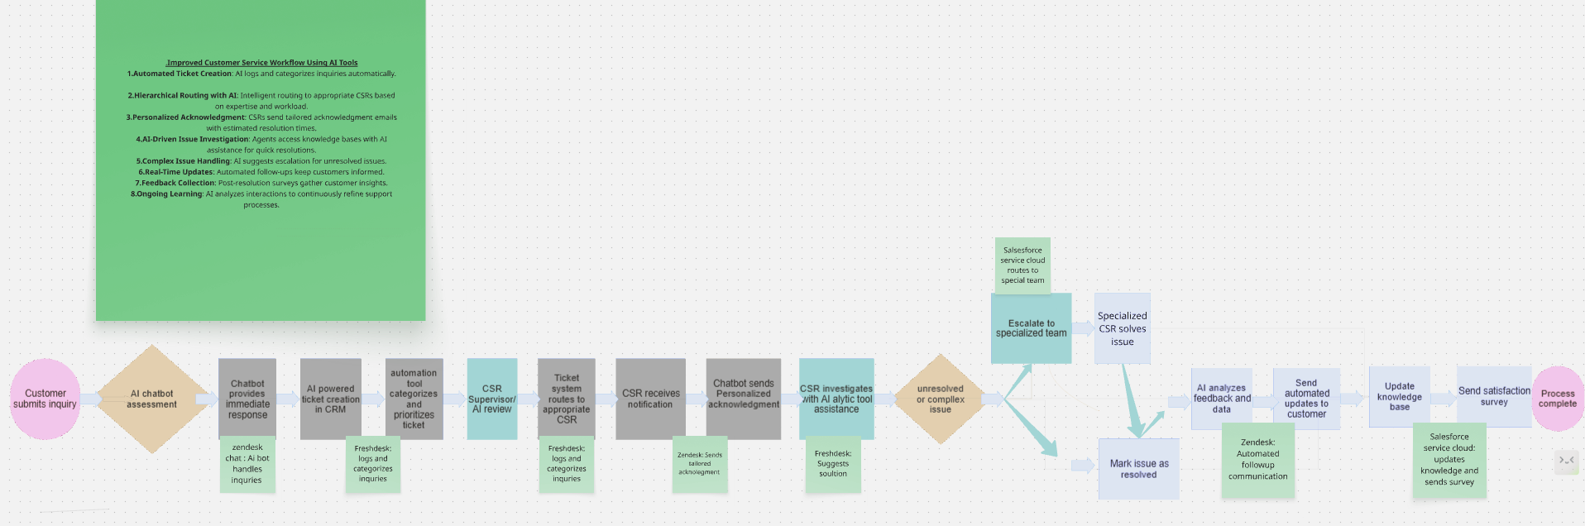
Updated Workflow with AI

Slide 10
Recommendations / Next Steps
1. Conduct a Pilot Program: Test AI tools in a controlled environment before full implementation.
2. Invest in Training: Provide comprehensive training for staff to enhance familiarity with AI tools.
3. Ensure Data Protection: Develop robust security protocols and regulatory compliance measures.
4. Set Clear Metrics for Success: Establish KPIs to evaluate AI integration effectiveness.
5. Encourage Continuous Feedback: Foster a culture of feedback to inform ongoing improvements.

Slide 11
Conclusion
Integrating AI tools into customer service is a strategic opportunity to enhance operational efficiency and improve customer satisfaction. By leveraging systems like Zendesk, Freshdesk, and Salesforce Service Cloud, the company can address current challenges and create a more responsive and effective customer service experience.

